Slide 1
SPATIAL OPERATIONS

Slide 2
GRAY-LEVEL TRANSFORMATION
FUNCTION
POINT PROCESSING,
s = T (r)
Contrast stretching
Thresholding
2

Slide 3
PROBLEM ON CONTRAST STRETCHING AND TRESHOLDING
Exercise:
the following matrix represents the pixels values of a 8-bit image (r) , apply thresholding transform assuming that the threshold m=95, find the resulting image pixel values.
Image (r)
solution:
110 | 120 | 90 | 130
91 | 94 | 98 | 200
90 | 91 | 99 | 100
82 | 96 | 85 | 90
Image (s)
3

Slide 4
PIECEWISE LINEAR TRANSFORMATION FUNCTIONS
Advantage
Arbitrarily complex
Disadvantage
More user input
Type of Transformations
Contrast stretching
Gray-level slicing
Bit-plane slicing
4

Slide 5
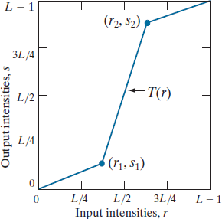
CONTRAST STRETCHING
The locations of points (r1 , s 1) and (r2 , s2 ) control the shape of the transformation function.
If r1 =s1 and r2= s 2 the transformation is a linear function that produces no changes in intensity.
If r1=r2 , s1 = 0, and
s2 =L − 1 the a thresholding
transformation becomes
function that creates a binary image
Intermediate values of (r 1, s1 ) and (s 2, r2 )
produce various degrees of spread in the
thus
intensity levels of the output image, affecting its contrast.
5

Slide 6
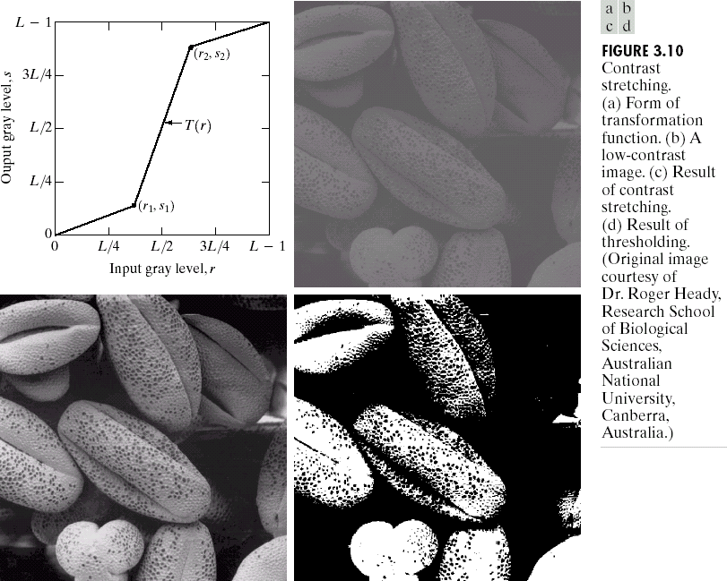
CONTRAST STRETCHING
Objective: Increase the dynamic range of the gray levels in the image
Causes for poor image
-Poor illumination
-Wrong lens aperture
-Wrong shutter speed
-Lack of dynamic range in the imaging sensor
S = r-c [b-a/d-c]+a
a = s1 b = s2 c = r1 d = r2
6

Slide 7
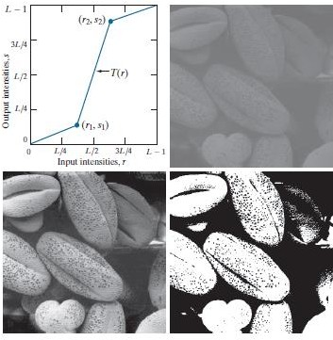

CONTRAST STRETCHING
Fig (c ) contrast stretching
( r1,s1) = (r min, 0) and
(r2,s2)=( rmax, L-1)
rmin and rmax denote the minimum and maximum intensity levels in the input image.
Fig(d) Thresholding
(r1,s1) = (m, 0) and
(r2,s2)=( m, L-1) m is
the mean
intensity level in the image
7

Slide 8
GRAY LEVEL SLICING
Objective: Highlighting a specific range of gray levels in an image.
8

Slide 9
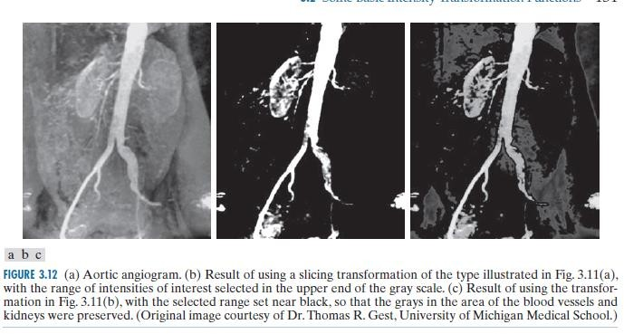
GRAY LEVEL SLICING
9

Slide 10
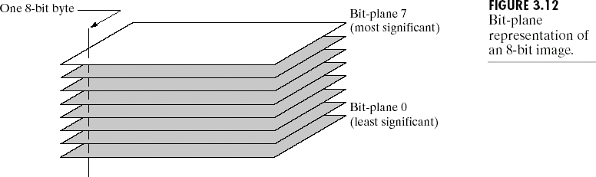
255 138 30
BIT-PLANE SLICING - HIGHLIGHT THE CONTRIBUTION MADE TO TOTAL IMAGE APPEARANCE BY SPECIFIC BITS
65 12 201
180 111 85
LSB MSB
1 1 1 1 1 1 1 1
0 1 0 1 0 0 0 1
1 1 1 1 1 0 0 0
1 0 0 0 0 0 1 0
0 0 1 1 0 0 0 0
1 0 0 1 0 0 1 1
1 1 1 0 1 1 0 1
1 1 1 1 0 1 1 0
1 0 1 0 1 0 1 0
MSB plane 1 1 0
0 0 1
1 0 0
255
138
30
65
12
201
183
111
85
LSB plane
1 0 1
1 0 1
1 1 1
10

Slide 11
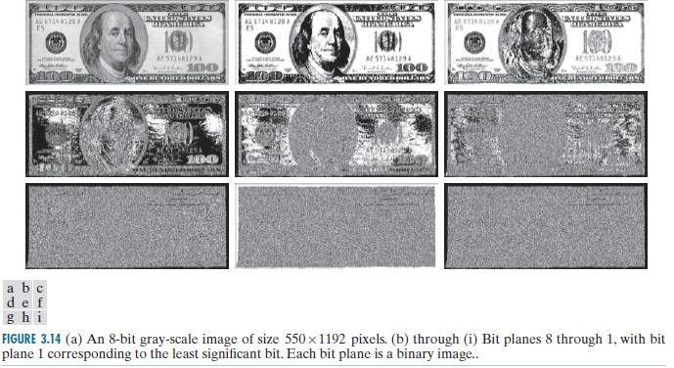
BIT PLANE SLICING
11

Slide 12
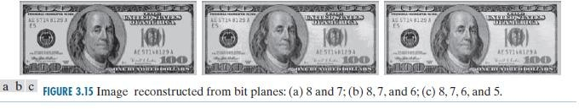
IMAGE RECONSTRUCTION USING SLICED PLANES
Multiply bit plane 8 by 128, bit plane 7 by 64, and added the two planes. Although the main features of the original image were restored, the reconstructed image appears flat, especially in the background.
12

Slide 13
THANK YOU
13

